Slide 1
SENSITIVITY OF BLACK CARBON AGING TO MODELING ASSUMPTIONS IN CAM-CHEM
Yinrui Li
Advisor: Prof. Nicole Riemer & Prof. Donald Wuebbles
Department of Atmospheric Science
Acknowledgement: This work is supported by the Center for Space and Earth Sciences, Los Alamos National Laboratory, Laboratory Directed Research and Development Program.

Slide 2
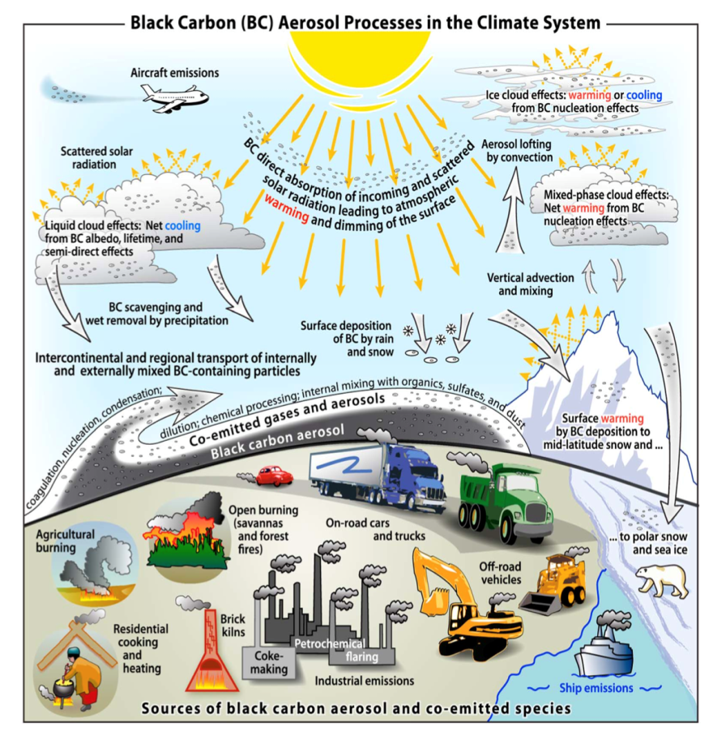
Black Carbon Aerosol and its Climate Effect
BC aerosol processes
Black carbon sources:
Incomplete combustion from biomass burning, biofuel burning, and anthropogenic activities.
(Bond et al., 2013)
BC Climate Effect
BC strongly absorbs visible light, ranked as the 2nd largest anthropogenic warming agent (1.1 W/m²) after CO₂ (1.6 W/m²). [1]
Large uncertainties (0.17 to 2.1 W/m²) exist in climate models. [1]
Limited understanding of aging is one key contribution to the uncertainties of estimating BC burden and climate effect.
BC Climate Effect
BC strongly absorbs visible light, ranked as the 2nd largest anthropogenic warming agent (1.1 W/m²) after CO₂ (1.6 W/m²). [1]
Large uncertainties (0.17 to 2.1 W/m²) exist in climate models. [1]
Limited understanding of aging is one key contribution to the uncertainties of estimating BC burden and climate effect.
BC Climate Effect
BC strongly absorbs visible light, ranked as the 2nd largest anthropogenic warming agent (1.1 W/m²) after CO₂ (1.6 W/m²). [1]
Large uncertainties (0.17 to 2.1 W/m²) exist in climate models. [1]
Limited understanding of aging is one key contribution to the uncertainties of estimating BC burden and climate effect.
BC Climate Effect
BC strongly absorbs visible light, ranked as the 2nd largest anthropogenic warming agent (1.1 W/m²) after CO₂ (1.6 W/m²). [1]
Large uncertainties (0.17 to 2.1 W/m²) exist in climate models. [1]
Limited understanding of aging is one key contribution to the uncertainties of estimating BC burden and climate effect.
Notes:
BC strongly absorbs visible light, ranked as the 2nd largest anthropogenic warming agent (1.1 W/m²) after CO₂ (1.6 W/m²).
Large uncertainties (0.17 to 2.1 W/m²) exist in climate models.
Limited understanding of aging is one key contribution to the uncertainties of estimating BC burden and climate effect

Slide 3
Black Carbon Aerosol and its Climate Effect
BC aerosol processes
Black carbon aging:
BC particles are coated with other aerosol species
This changes CCN properties and optical properties
(Bond et al., 2013)
BC Climate Effect
BC strongly absorbs visible light, ranked as the 2nd largest anthropogenic warming agent (1.1 W/m²) after CO₂ (1.6 W/m²). [1]
Large uncertainties (0.17 to 2.1 W/m²) exist in climate models. [1]
Limited understanding of aging is one key contribution to the uncertainties of estimating BC burden and climate effect.
BC Climate Effect
BC strongly absorbs visible light, ranked as the 2nd largest anthropogenic warming agent (1.1 W/m²) after CO₂ (1.6 W/m²). [1]
Large uncertainties (0.17 to 2.1 W/m²) exist in climate models. [1]
Limited understanding of aging is one key contribution to the uncertainties of estimating BC burden and climate effect.
BC Climate Effect
BC strongly absorbs visible light, ranked as the 2nd largest anthropogenic warming agent (1.1 W/m²) after CO₂ (1.6 W/m²). [1]
Large uncertainties (0.17 to 2.1 W/m²) exist in climate models. [1]
Limited understanding of aging is one key contribution to the uncertainties of estimating BC burden and climate effect.
BC Climate Effect
BC strongly absorbs visible light, ranked as the 2nd largest anthropogenic warming agent (1.1 W/m²) after CO₂ (1.6 W/m²). [1]
Large uncertainties (0.17 to 2.1 W/m²) exist in climate models. [1]
Limited understanding of aging is one key contribution to the uncertainties of estimating BC burden and climate effect.
Notes:
BC strongly absorbs visible light, ranked as the 2nd largest anthropogenic warming agent (1.1 W/m²) after CO₂ (1.6 W/m²).
Large uncertainties (0.17 to 2.1 W/m²) exist in climate models.
Limited understanding of aging is one key contribution to the uncertainties of estimating BC burden and climate effect

Slide 4
Black Carbon Aerosol and its Climate Effect
BC aerosol processes
Black carbon removal:
Wet deposition: rainout, washout
dry deposition
(Bond et al., 2013)
BC Climate Effect
BC strongly absorbs visible light, ranked as the 2nd largest anthropogenic warming agent (1.1 W/m²) after CO₂ (1.6 W/m²). [1]
Large uncertainties (0.17 to 2.1 W/m²) exist in climate models. [1]
Limited understanding of aging is one key contribution to the uncertainties of estimating BC burden and climate effect.
BC Climate Effect
BC strongly absorbs visible light, ranked as the 2nd largest anthropogenic warming agent (1.1 W/m²) after CO₂ (1.6 W/m²). [1]
Large uncertainties (0.17 to 2.1 W/m²) exist in climate models. [1]
Limited understanding of aging is one key contribution to the uncertainties of estimating BC burden and climate effect.
BC Climate Effect
BC strongly absorbs visible light, ranked as the 2nd largest anthropogenic warming agent (1.1 W/m²) after CO₂ (1.6 W/m²). [1]
Large uncertainties (0.17 to 2.1 W/m²) exist in climate models. [1]
Limited understanding of aging is one key contribution to the uncertainties of estimating BC burden and climate effect.
BC Climate Effect
BC strongly absorbs visible light, ranked as the 2nd largest anthropogenic warming agent (1.1 W/m²) after CO₂ (1.6 W/m²). [1]
Large uncertainties (0.17 to 2.1 W/m²) exist in climate models. [1]
Limited understanding of aging is one key contribution to the uncertainties of estimating BC burden and climate effect.
Notes:
BC strongly absorbs visible light, ranked as the 2nd largest anthropogenic warming agent (1.1 W/m²) after CO₂ (1.6 W/m²).
Large uncertainties (0.17 to 2.1 W/m²) exist in climate models.
Limited understanding of aging is one key contribution to the uncertainties of estimating BC burden and climate effect

Slide 5
Black Carbon Aerosol and its Climate Effect
BC aerosol processes
Black carbon impacts:
direct absorption or scattering of incoming solar radiation (warming)
Indirect effect as CCN and semi-direct effect (cooling)
Deposition to snow and ice (reduce surface albedo, warming)
(Bond et al., 2013)
BC Climate Effect
BC strongly absorbs visible light, ranked as the 2nd largest anthropogenic warming agent (1.1 W/m²) after CO₂ (1.6 W/m²). [1]
Large uncertainties (0.17 to 2.1 W/m²) exist in climate models. [1]
Limited understanding of aging is one key contribution to the uncertainties of estimating BC burden and climate effect.
BC Climate Effect
BC strongly absorbs visible light, ranked as the 2nd largest anthropogenic warming agent (1.1 W/m²) after CO₂ (1.6 W/m²). [1]
Large uncertainties (0.17 to 2.1 W/m²) exist in climate models. [1]
Limited understanding of aging is one key contribution to the uncertainties of estimating BC burden and climate effect.
BC Climate Effect
BC strongly absorbs visible light, ranked as the 2nd largest anthropogenic warming agent (1.1 W/m²) after CO₂ (1.6 W/m²). [1]
Large uncertainties (0.17 to 2.1 W/m²) exist in climate models. [1]
Limited understanding of aging is one key contribution to the uncertainties of estimating BC burden and climate effect.
BC Climate Effect
BC strongly absorbs visible light, ranked as the 2nd largest anthropogenic warming agent (1.1 W/m²) after CO₂ (1.6 W/m²). [1]
Large uncertainties (0.17 to 2.1 W/m²) exist in climate models. [1]
Limited understanding of aging is one key contribution to the uncertainties of estimating BC burden and climate effect.
Notes:
BC strongly absorbs visible light, ranked as the 2nd largest anthropogenic warming agent (1.1 W/m²) after CO₂ (1.6 W/m²).
Large uncertainties (0.17 to 2.1 W/m²) exist in climate models.
Limited understanding of aging is one key contribution to the uncertainties of estimating BC burden and climate effect

Slide 6
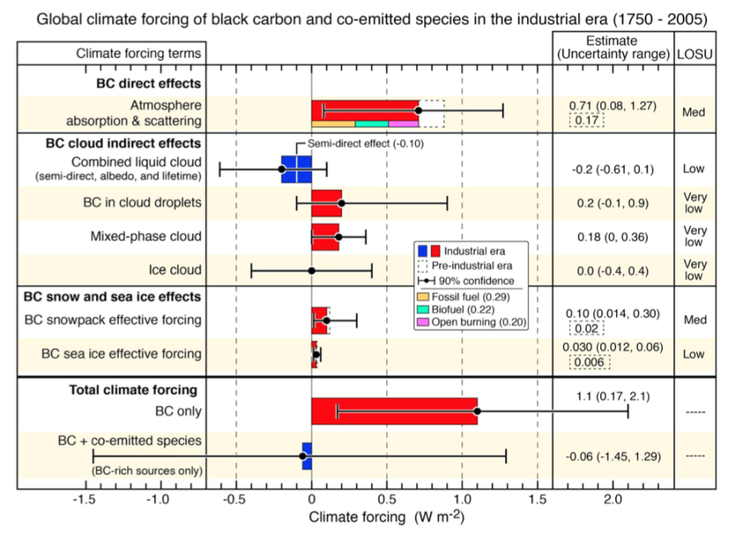
BC Climate Effect
BC Direct, Indirect and Snow/Ice Effect
(Influential assessment paper, Bond et al., 2013)
Black Carbon aerosol: the 2nd largest anthropogenic warming agent (1.1 W/m²) after CO₂ (1.6 W/m²).
Large uncertainties (0.17 to 2.1 W/m²) exist in climate models.
One key process that affect climate related properties is its aging process.

Slide 7
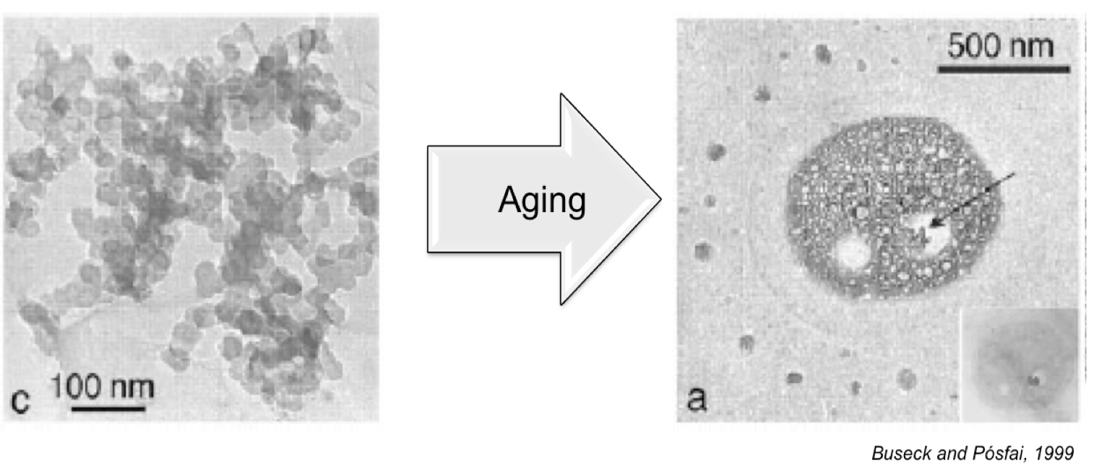
Black Carbon Aging
Conversion of fresh, hydrophobic black carbon into aged, hydrophilic black carbon.
Directly contributing to changes in CCN properties, optical properties and wet removal.
Difficulties to represent aging in models is one key contribution to the uncertainties of estimated BC burden and climate effect (it is hard to track individual particle in a global scale model).

Slide 8
Objectives
In the study, we explore the sensitivity of CAM-chem model simulated BC burden and radiative forcing to the aging criterion used in CAM-chem.
Currently, no observed data of aging rates is available. Furthermore, it is hard to obtain observed data of a ‘process’.
New idea: we compare BC aging rates in CAM-chem to the aging parameterization based on more detailed particle-resolved simulations with PartMC-MOSAIC.
Notes:
Currently, it is difficult to compare model simulated aging rates directly with observed data.

Slide 9
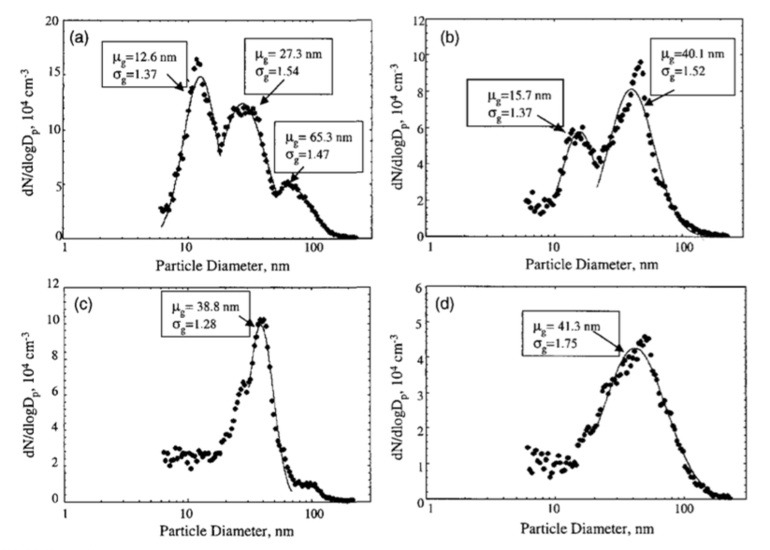
Introduction to Modal Aerosol Model
Fitted Multimodal Distributions
Modes:
Aerosol particle size distributions can be divided into “modes”.
Modes are regions of the size distribution in which distinct peaks in occur.
Modes can be described analytically with a lognormal distribution function.
(Seinfeld et al., 2006)
Previous studies have found that lognormal distribution is a good approximation of particle size distributions.
Notes:
The modes often reflect the way how the particles are brought into the atmosphere.

Slide 10
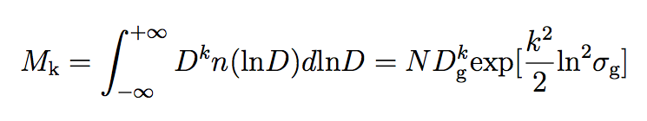
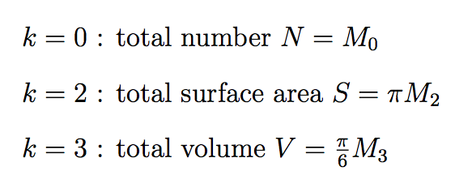
Introduction to ‘Moment’
Moment is the expected value of D^{k}.
The mathematical expression of the k^{th} moment is defined as:
In a mode, the 0th , 2nd , and 3rd moment are analogous to the particle number N, surface area S, and volume V respectively:
Notes:
No differential equation of sigma and mu. So they can not be solved directly. We have to rely on the moment dynamic equation.

Slide 11
What to do with Moments and Modes
General Dynamic Equation:
Step 1: Integrate the above equation after multiplying D^{k}, to get the moment dynamic equation.
Step 2: Solve for M₀, M₂ and M₃ after each time step.
Step 3: Solve for , N and after each time step.
Particle size distribution in each mode is evolved, based on GDE.

Slide 12
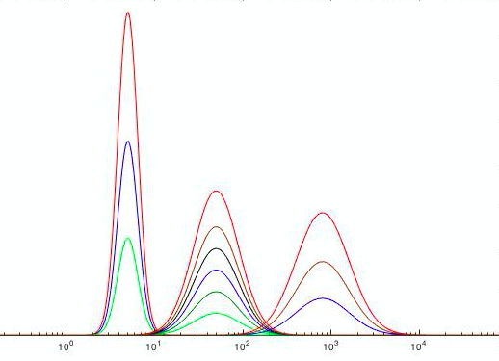
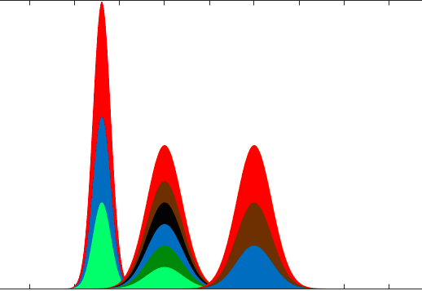
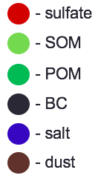

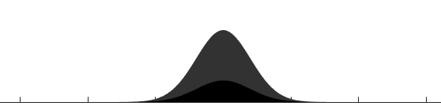
A Schematic of the 4-mode Version of Modal Aerosol Model (MAM4)
MAM4 | σ_{g} | Size range (μm)
Aitken | 1.6 | 0.015-0.053
Accumulation | 1.8 | 0.058-0.27
Primary carbon | 1.6 | 0.039-0.13
Coarse | 1.8 | 0.80-3.65
(Liu et al., 2015)
10⁰ 10¹ 10² 10³ 10⁴
Aitken Accumulation Coarse
Coagulation
Condensation
Primary carbon mode: fresh, externally mixed, hydrophobic, not subject to wet deposition
Accumulation mode: aged, internally mixed, hydrophilic, subject to wet deposition
Aging Process
10⁰ 10¹ 10² 10³
Primary Carbon
Notes:
Other model can have more modes. (e.g., MAM7)

Slide 13
BC Aging and CCN Activation
Aging:
Conversion of BC particles from hydrophobic to hydrophilic after coating with other species.
Particles grow in Size.
CCN activation:
Less super-saturation ratio is required for larger particles to be ‘activated’.
However, in modal model, particles are activated (mass transferred between modes) regardless of their size.
Size increases

Slide 14
Condensation Scheme in MAM4
How exactly is ‘aging’ (conversion between modes) done?
Each time step, determine the amount of condensable material on primary carbon mode.
Determine what fraction of primary carbon this amount is able to age based on monolayer criterion.
Move this fraction of primary carbon + condensable material.
Condensation: “Monolayer-of-sulfate criterion”
An equivalent of 8-monolayers of sulfate is needed to transfer material from the primary carbon mode (fresh) into the accumulation mode (aged).
Attention:
Size distributions evolve! Particles are not tracked!
BC core
Monolayer depth = sulfate diameter

Slide 15
Condensation Scheme in MAM4
Condensation: “Monolayer-of-sulfate criterion”
Volume-mean size for BC/POM emissions: 134 nm.
Add 3 mono-layers of sulfate to 134-nm non-hygroscopic particle: Critical supersaturation is 0.49%
Add 8 mono-layers of sulfate to 134-nm non-hygroscopic particle: Critical supersaturation is 0.32%

Slide 16
General Effect of the Number of Mono-layers:
Increase in the number of mono-layers:
Larger amount of sulfate or SOA is needed to age the primary carbonaceous particles.
Particles will stay for longer in the primary carbon (no wet deposition) mode before moving into the accumulation mode (subject to wet deposition).
Consequences:
Less wet deposition.
BC can transport longer distances.
BC concentration increases.
BC core

Slide 17

Introduction to CAM-chem
CAM-chem model is a global 3-D atmospheric component of the NCAR Community Earth System Model (CESM)
We will run CAM5 through version CESM1_2_2:
One year simulation (2010) at 1.9° latitude ×2.5 ° longitude;
With offline meteorology field (GEOS-5) + interactive chemistry (MOSAIC-4)
With IPCC AR5 gridded POM and BC emissions for 1850-2010;

Slide 18
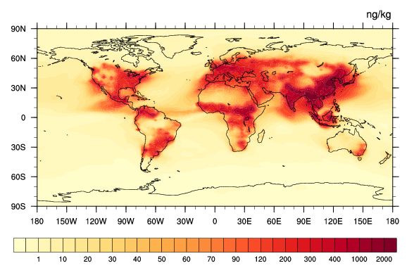
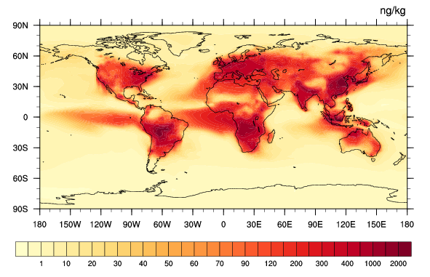
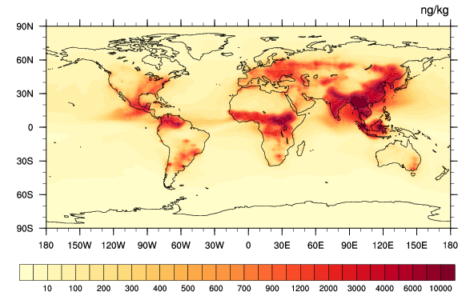
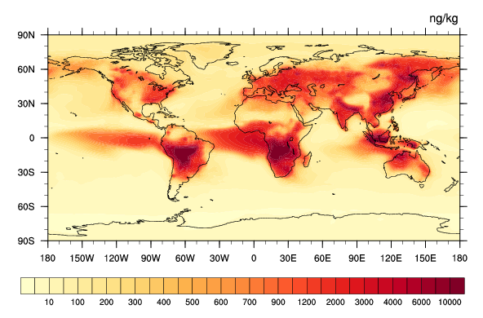
Aerosol Species Distribution in CAM-chem
March September
ng/kg
ng/kg
BC
OC
0 20 40 60 90 200 400 1000 2000
0 20 40 60 90 200 400 1000 2000
ng/kg
ng/kg
10 200 400 600 900 2000 4000 10000
10 200 400 600 900 2000 4000 10000
Notes:
Their concentrations range from near 0 at distant regions, such as the Arctic, to 2mg near the sources.

Slide 19
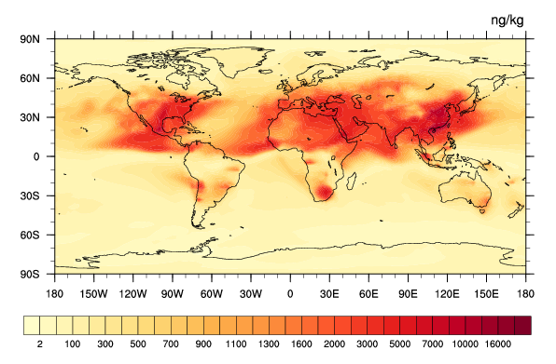
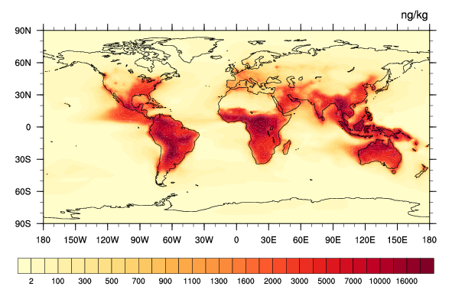
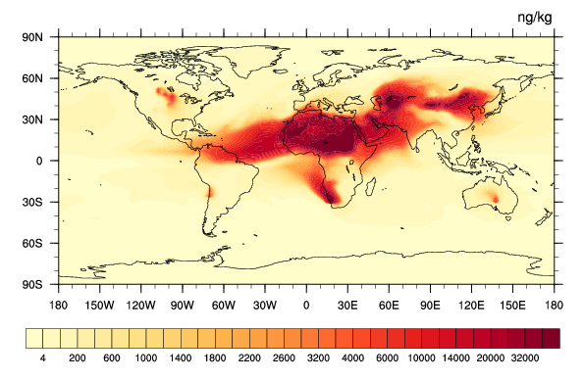
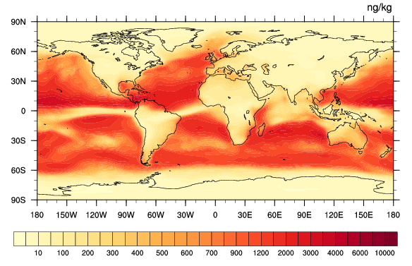
Aerosol Species Distribution in CAM-chem
Sulfate
SOA
ng/kg
mol/mol
ng/kg
0 100 500 1000 1500 3000 10000 20000
0 100 500 1000 1500 3000 10000 20000
Dust
ng/kg
Sea salt
ng/kg
0 200 1000 2000 3000 6000 15000 30000
0 100 300 500 700 1000 3000 6000 10000

Slide 20
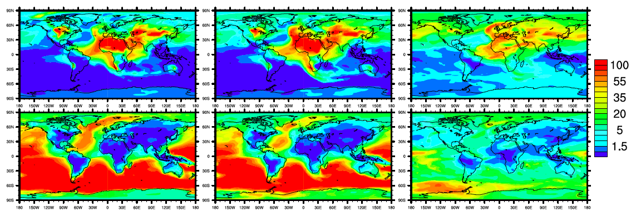
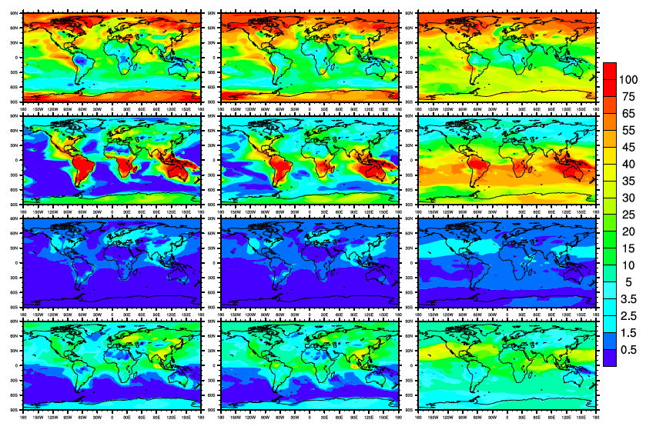
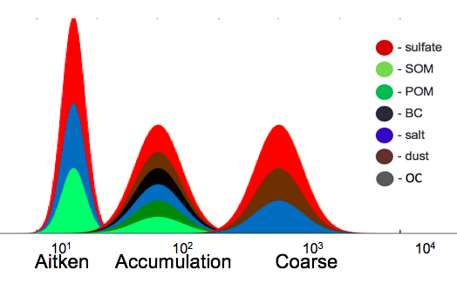
Composition - Accumulation Mode
992hPa
992 hPa
Sulfate
SOA
BC
OC
dust
sea salt
(%)
Volume fraction (%)

Slide 21
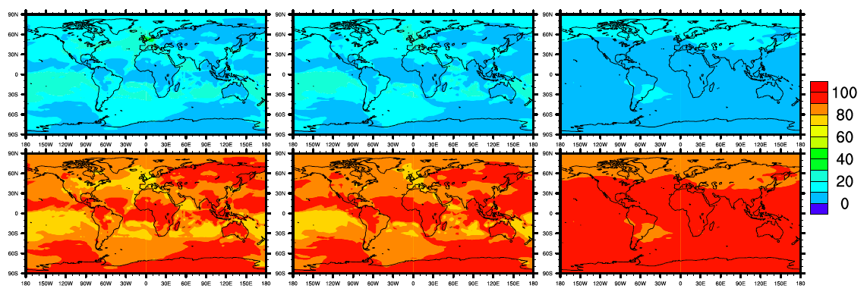
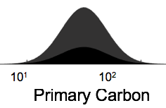
Composition - Primary Carbon Mode
992 hPa
BC
OC
Volume fraction (%)

Slide 22
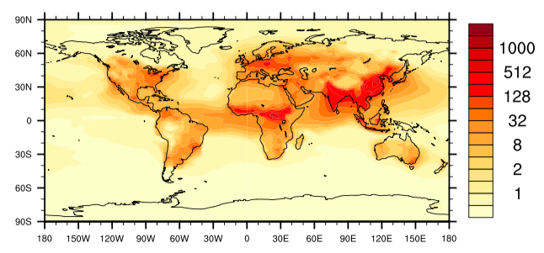
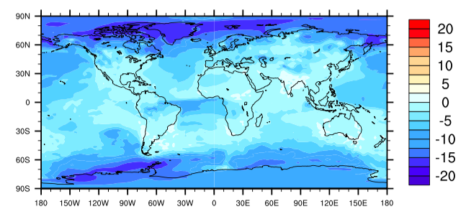
Sensitivity of BC Burden to the Number of Monolayers
Annual BC Mass Mixing Ratio (992hPa)
L8 (default)
ng/kg
Relative Difference (992hPa)
(L1– L8) / L8
L1: 1 monolayer
L8: 8 monolayers
%
Relative differences are highest at high latitudes (distant from the sources).

Slide 23
Vertical Profile of Regional BC Burden to the Number of Monolayers
March
1
2
4
8
1 monolayer
2 monolayers
4 monolayers
8 monolayers
Higher sensitivity for distant regions (e.g., region 1 & 2)
Maximum relative difference can be at high altitudes (e.g., region 2).
Notes:
Arctic: special concern because the climate there are more sensitive to BC (surface albedo effect)
Scales are differenct

Slide 24
Seasonal Variation of Regional BC Burden
September
1
4
8
1 monolayer
2 monolayers
4 monolayers
8 monolayers
2
More biomass burning activities.
BC is ‘pumped’ up into higher layer.

Slide 25
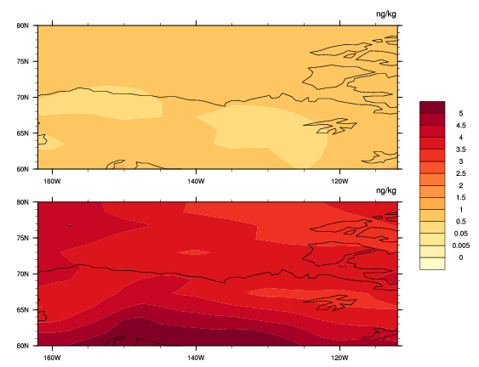
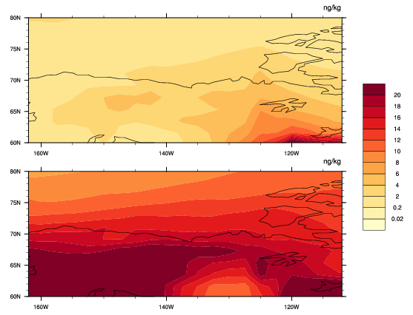
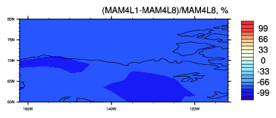
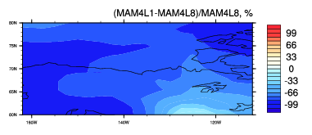
Sensitivity of BC Burden to Aging Criterion – Arctic Region
March
September (857hPa)
L1
L8
BC distribution patterns are different between L1 case and L8 case.
(L1-L8)/L8

Slide 26
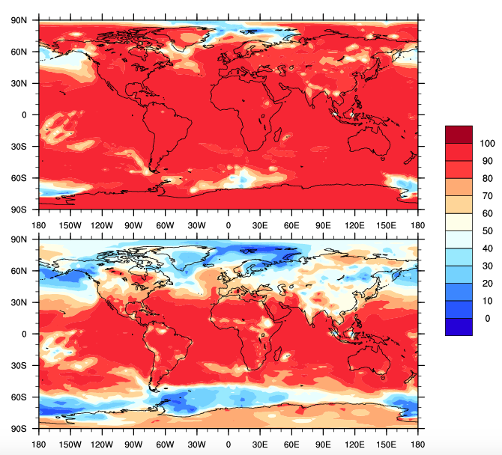
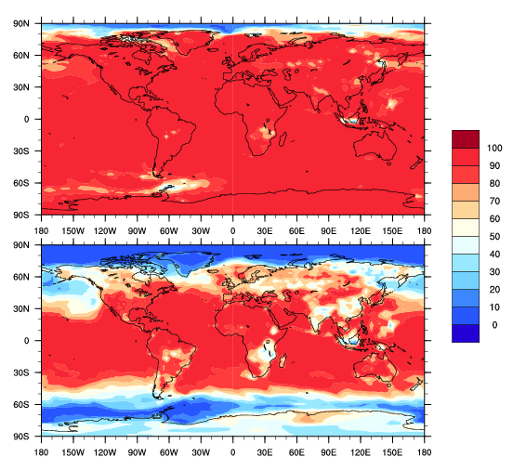
BC Mixing State Sensitivity to Aging Criterion
BC Ratio in CAMChem (BC in Accumulation Mode/Total BC)
March (992hPa) September (992hPa)
L1
L1
L8
L8
In the Arctic:
Most of BC is in primary carbon mode (externally mixed)!

Slide 27
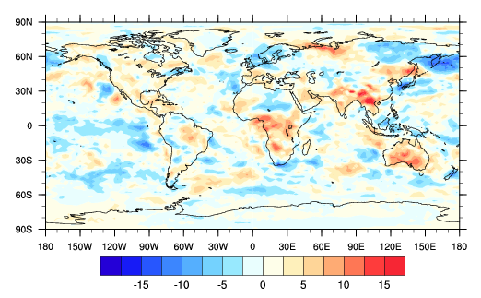
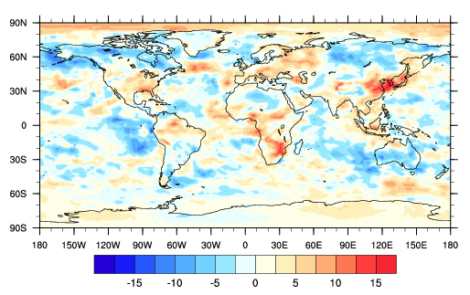
Annual Direct Radiative Forcing of BC Aerosols
1-monolayer
8-monolayer
W/m2
W/m2
Mean: 0.18 W/m2
Mean: 0.48 W/m2
BC direct radiative forcing is higher in L8 case.

Slide 28
Question: How to Determine the ‘Correct’ Number of Mono-layer
In a first-order aging model, the transition of BC mass from fresh to aged mode can be represented by an aging timescale :
This aging timescale can be distributed into condensation and coagulation timescales:

Slide 29
Aging Timescales Extracted from CAM-chem
Mass transfer rates
Step1: Compute the condensation and coagulation aging timescale as the inverse of their mass transfer rate from primary carbon mode (fresh) to accumulation mode (aged).
Step2: Compute the total aging timescale as their harmonic mean.

Slide 30
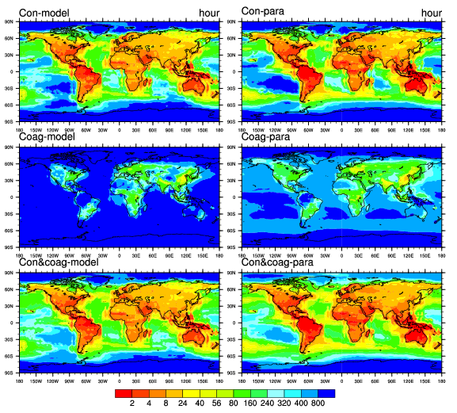
Contribution from Condensation and Coagulation – Annual Mean, 992hPa
CAM-chem
Condensation
Coagulation
Overall
Condensation plays a dominating role.
Aging timescales range from less than one hour to several days.

Slide 31
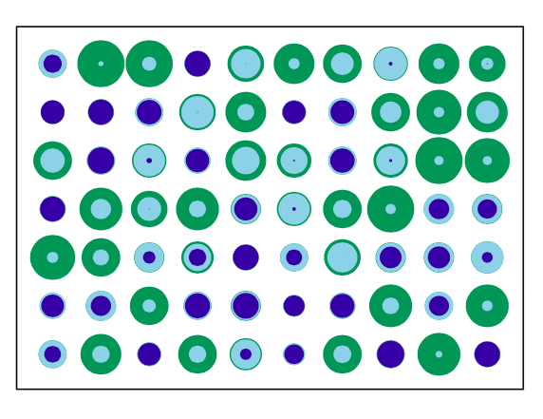
Particle Resolved Model Representation of Aerosols
Particle Resolved Model
PartMC-MOSAIC:
It track the evolution of individual particles (mass constituent aerosol species). (Riemer et al., 2009).
The processes of advection, diffusion and coagulation are modeled stochastically.
Advantage: No specific aging criterion assumption is required.

Slide 32
PartMC Parameterization of Aging Timescales
Previous study has found a parameterization of BC aging timescale (Fierce et al., 2016), based on a series of 100 sensitivity scenarios, and parametric regression.
The parameterization is:
condensation coagulation
I_{cond}: total volumn condensation rate over surface area
N: total aerosol number concentration
Notes:
Important of process comparison, separate individual process

Slide 33
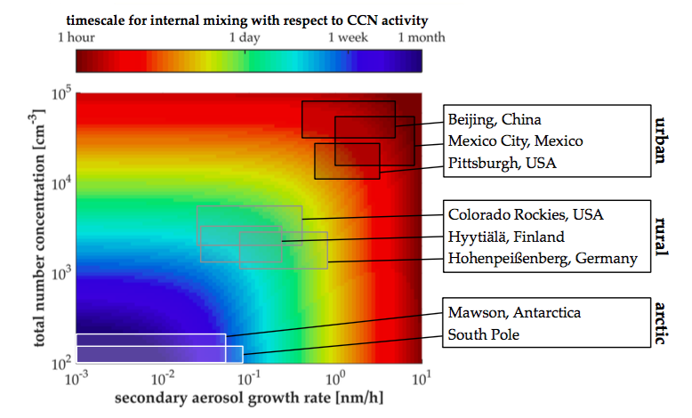
PartMC Aging Timescales
(Fierce et al., 2016)

Slide 34
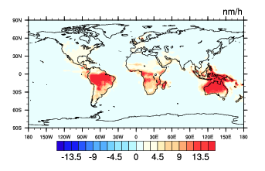
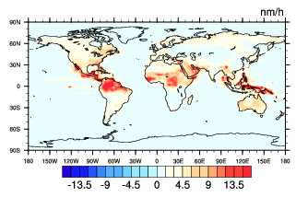
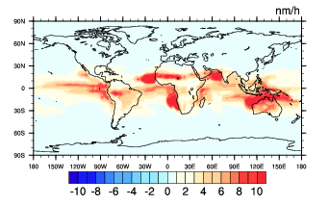
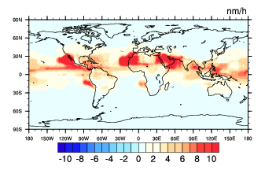
Volume Condensation Rate in Primary Carbon Mode
March September
nm/h
nm/h
992hPa
859hPa

Slide 35
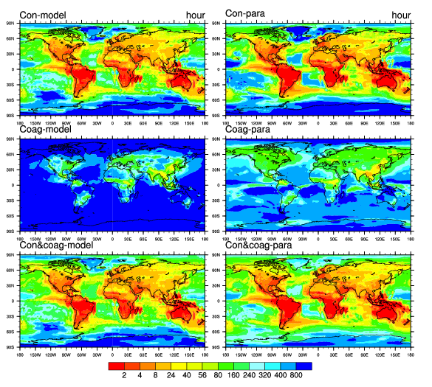
Comparison between CAM-chem and PartMC Aging Timescales – March
CAM-chem
PartMC-MOSAIC
CAM-chem:
Condensation
Coagulation
Overall
PartMC:
Condensation plays a dominating role.
Aging timescales range from less than one hour to several days.
PartMC timescales broadly consistant with CAM-chem timescales

Slide 36
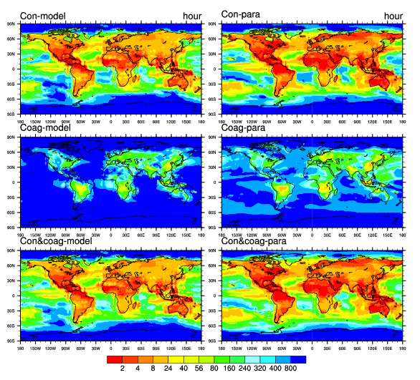
Comparison between CAM-chem and PartMC Aging Timescales – September
CAM-chem
PartMC-MOSAIC
Condensation
Coagulation
Overall
Seasonal variability can be observed

Slide 37
Comparison between CAM-chem and PartMC Aging Timescales – Annual Mean, 992hPa
CAM-chem
PartMC-MOSAIC
Condensation
Coagulation
Overall
MAM4 aging timescales broadly consistent with PartMC MOSAIC aging timescales near the surface.
Highest Differences of aging timescales exist in distant regions.

Slide 38
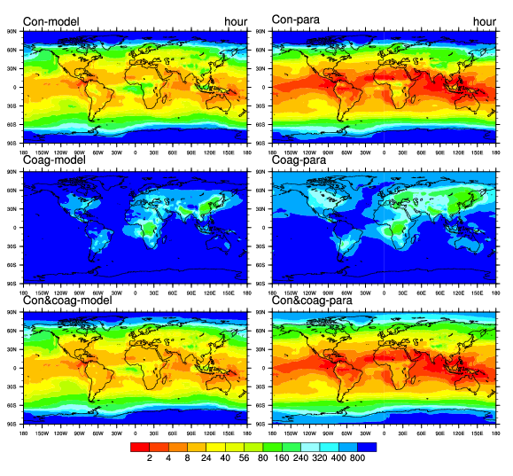
Comparison between CAM-chem and PartMC Aging Timescales – Annual Mean, 857hPa
CAM-chem
PartMC-MOSAIC
Condensation
Coagulation
Overall
MAM4 aging timescales higher than PartMC MOSAIC aging timescales in an upper layer, indicating slower aging rates.

Slide 39
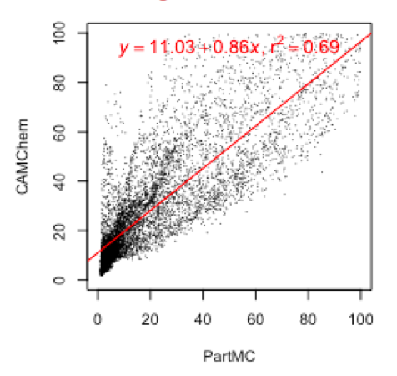
Scatter Plots of Annual Mean Aging Timescales – 992hPa
L1
L2
L4
L6
L8
When using an 8-monolayer sulfate criterion, the aging timescales have the closest linear-regression slope to 1 among the six sensitivity cases.

Slide 40
Scatter Plots of Annual Mean Aging Timescales – 857hPa
L1
L2
L4
L6
L8
When using an 6-monolayer sulfate criterion, the aging timescales have the closest linear-regression slope to 1 among six sensitivity cases.

Slide 41
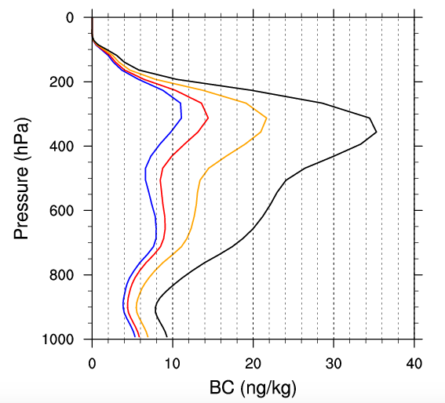
Conclusions
1. Sensitivity Analysis to the Aging Criterion
Relative Difference (L1-L8)/L8
2. BC burden most sensitive at high latitudes (maximum relative difference of 16%)
1. Relative differences can be largest at high altitudes for some distant regions.
1-monolayer
8-monolayer
Accumulation/total
3. The annual radiative forcing is higher when using a larger number of monolayers.
L1
L8
W/m2
W/m2
4. Most BC aerosols (> 90%) are externally mixed in the Arctic.

Slide 42
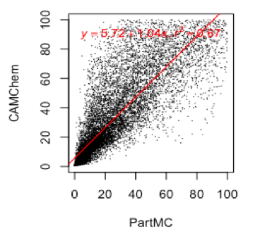
Conclusions
2. Process Analysis of Aging Timescales
2. Condensation of SOA and sulfate plays a dominating role.
Con
Coag
Total
1. Aging timescales range from less than one hour to several days.
L8
3. MAM4 aging timescales broadly consistent with PartMC MOSAIC aging timescales near the surface.

Slide 43
Future Work
Compare simulated BC burden with SP2 data.
Analysis model sensitivity to BC emission diameter (134 nm by default);

